Slide 1
A Brief Introduction to Capsule

Slide 2
How do CNNs work?
Layers that are lower will learn to detect simple features such as edges and color gradients, whereas higher layers will combine simple features into more complex features.

Slide 3
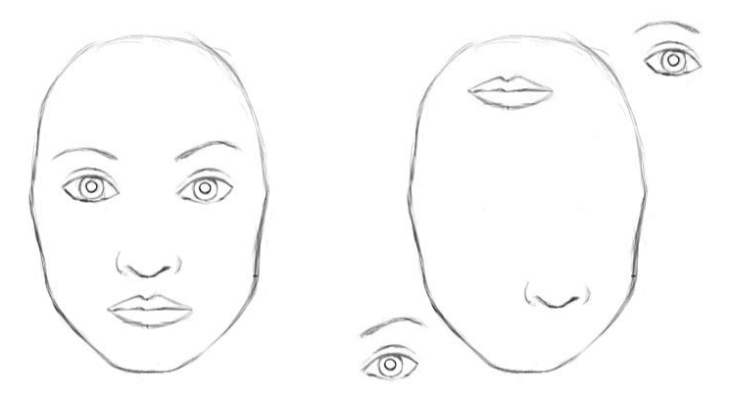
CNN’s drawbacks
CNNs can’t learn the orientation and relative spatial relationships between the components well.

Slide 4
CNN’s drawbacks
Pose (translational and rotational) relationship between simpler features make up a higher level feature
CNN approach to solve this issue is to use max pooling that reduce spacial size of the data flowing through the network, thus allowing them to detect higher order features in a larger region of the input image.
while CNNs work better than any model before them, max pooling nonetheless is losing valuable information.

Slide 5
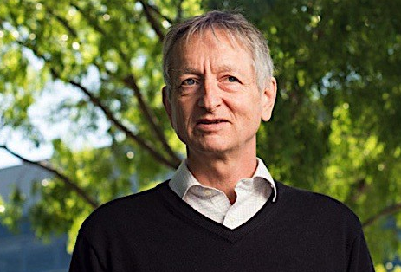
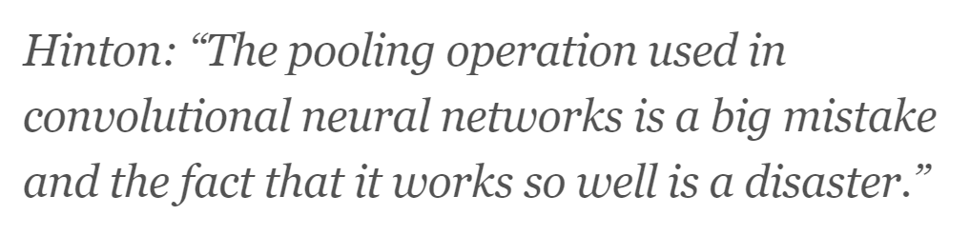

Slide 6
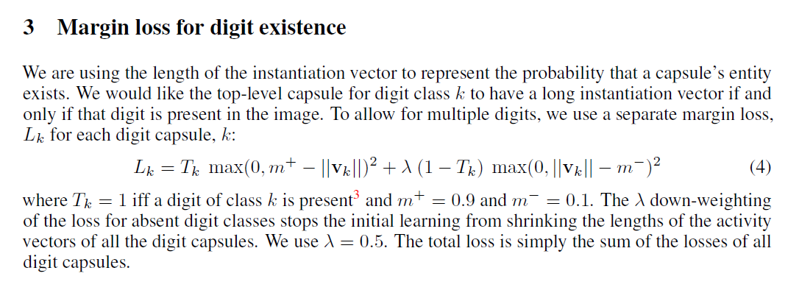
Loss Function

Slide 7
2 Key Ideas of CapsNet
Replacing the scalar-output feature detectors of CNNs with vector-output capsules
use the overall length of the vector of instantiation parameters to represent the existence of the entity and to force the orientation of the vector to represent the properties of the entity.
Replacing max-pooling with "routing-by-agreement"

Slide 8
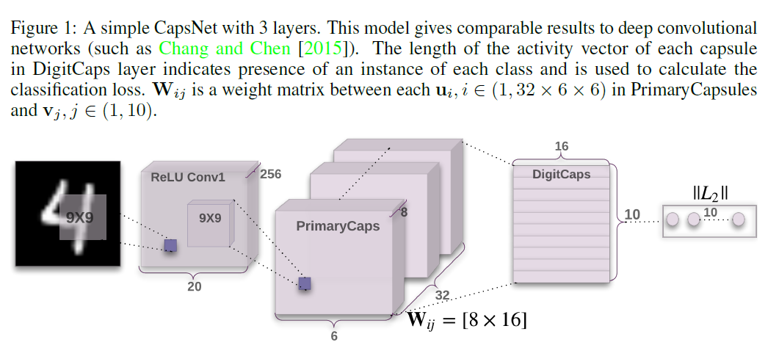
Architecture
u_i (1*1*8)
v_j (1*16)

Slide 9
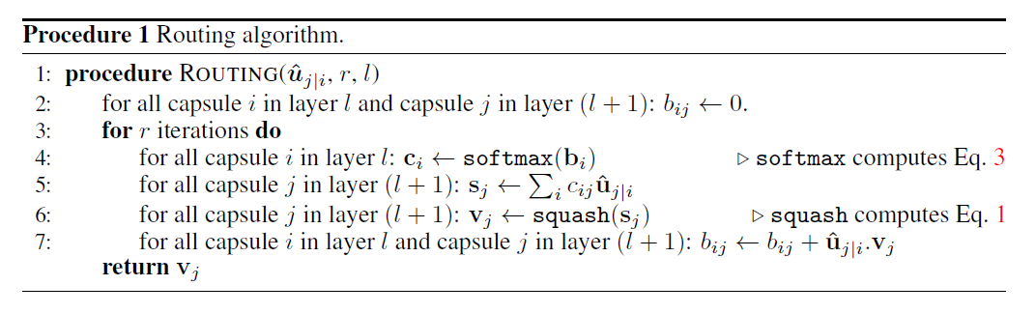



Dynamic Routing Mechanism
If for a certain j, most u_j|i are similar,
then s_j, v_j, u_j|I are all similar to each other
Then the product of u_j|I and v_j is large
Then b_ij (and c_ij)goes bigger
Then s_j (and v_j) become bigger for this j

Slide 10
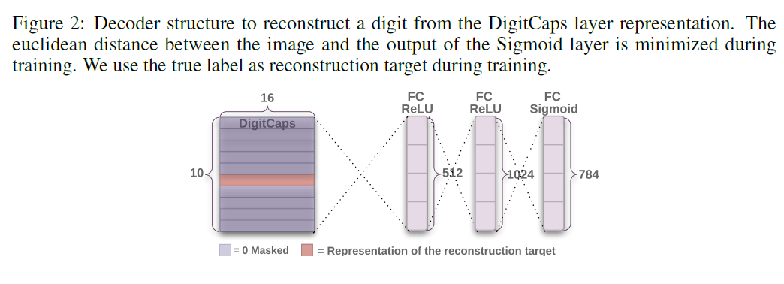
Reconstruction as a regularization method

Slide 11
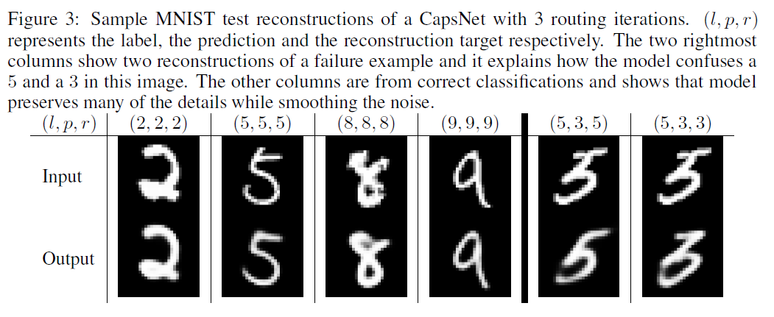
Reconstruction as a regularization method
Full loss = margin loss + \alpha* reconstruction loss

Slide 12
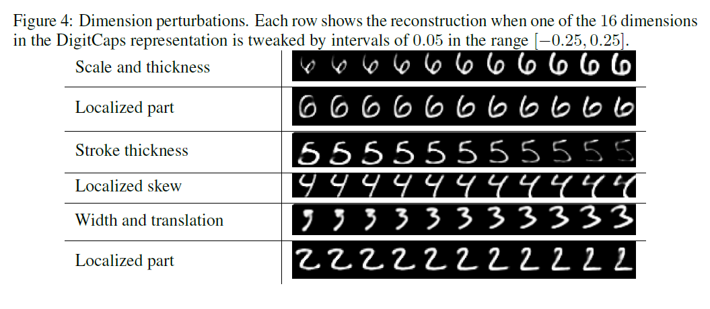
What the individual dimensions of a capsule represent
One dimension (out of 16) of the capsule almost always represents the width of the digit
Others include stroke thickness, skew and width

Slide 13
Robustness to Affine Transformations
tested on the affNIST data set in which each example is an MNIST digit with a random small affine transformation
accuracy | CapsNet | traditional CNN
MNIST | 99.23% | 99.22%
affNIST | 79% | 66%

